Slide 1
Ticketstar: A MOVIE TICKET BOOKING WEBSITE
Megana Reddy Boddam
Sahana Pandurangi Raghavendra
May 25, 2022
8:00 pm - 8:20 pm

Slide 2
TABLE OF CONTENTS
01
02
03
SCENARIO
ARCHITECTURE
DATABASE
04
05
06
BUSINESS LOGIC
CLIENT INTERFACE
DEMO
Notes:
01 scenario – need to speak on what does our website do?

Slide 3
01
SCENARIO

Slide 4

Imagine you want to watch a movie …

Slide 5

But there is a long line for the tickets …

Slide 6

You get to the end of line …

Slide 7
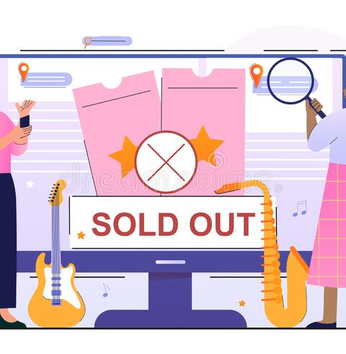
And the show is sold out for the day …

Slide 8

maybe you decide to see another movie …

Slide 9
But there is a long line for the food …

Slide 10

And the theater is out of popcorn …

Slide 11
CUSTOMER VALUE
Book tickets in advance, no need to wait in line, guaranteed spot in theater for show, guaranteed food at pickup

Slide 12
02
ARCHITECTURE

Slide 13
TECHNOLOGY STACK
Database
MiddleTier
FrontEnd
REST APIs
REST APIs
Oracle MySQL
Amazon RDS
Node.js
Amazon Lambda Functions
HTML, CSS, Node.js
Amazon API Gateway, Postman, API keys, Visual Studio Code
Technology
Platform

Slide 14
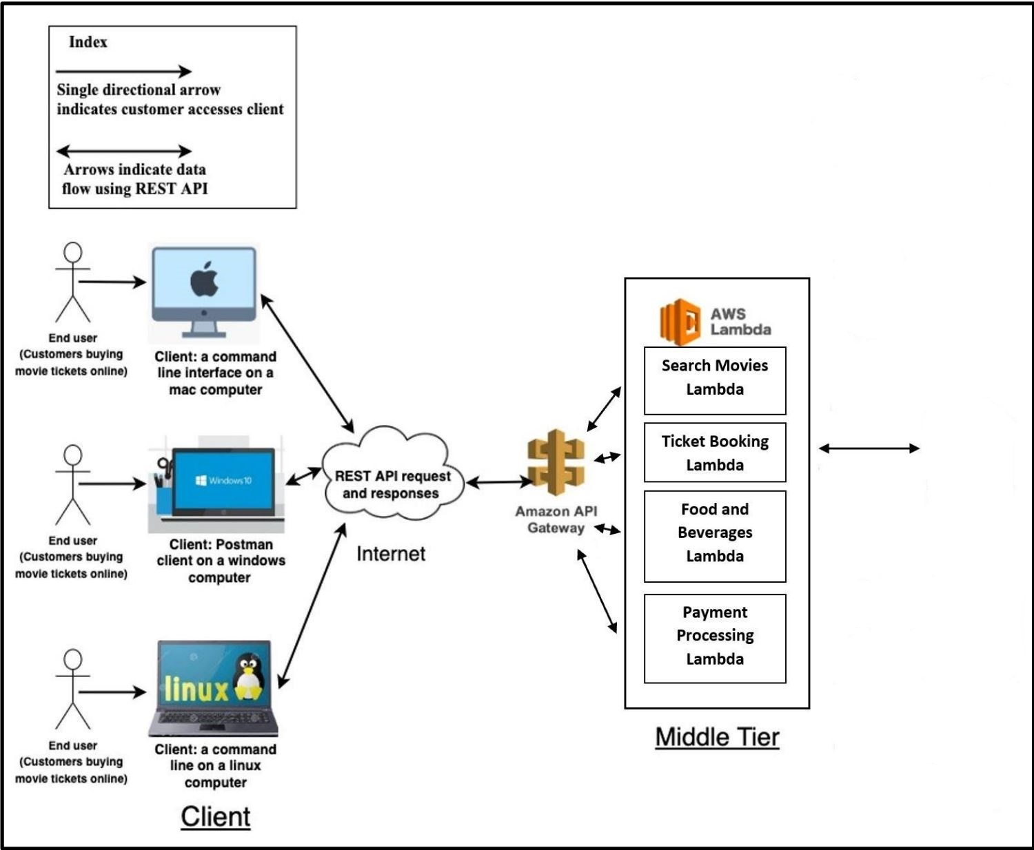



Client: Web Browser on a MAC Computer
Client: Web Browser on a windows computer
Client: Web Browser on a Linux Computer

Slide 15
03
DATABASE

Slide 16
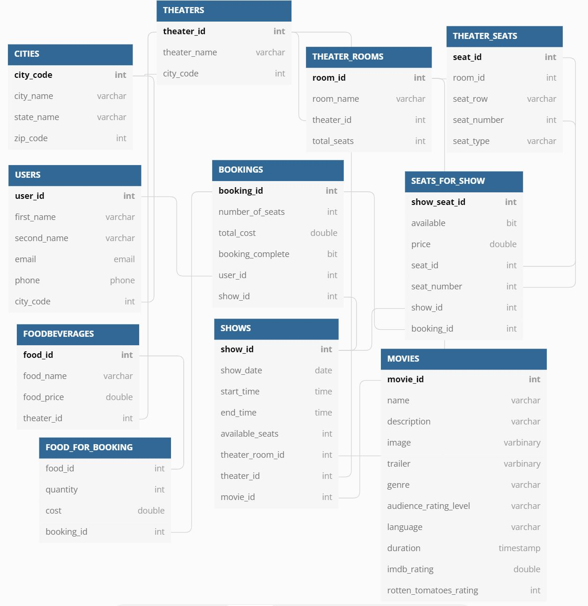
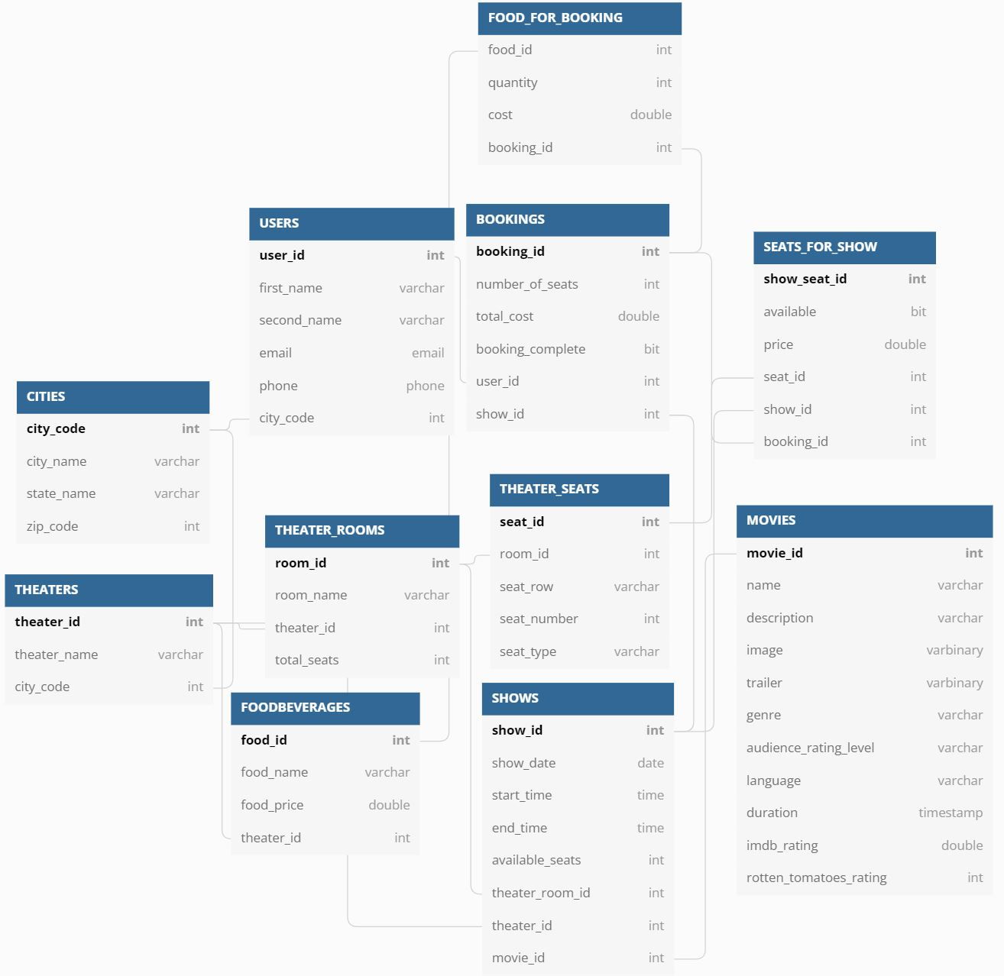

Slide 17
04
BUSINESS LOGIC

Slide 18
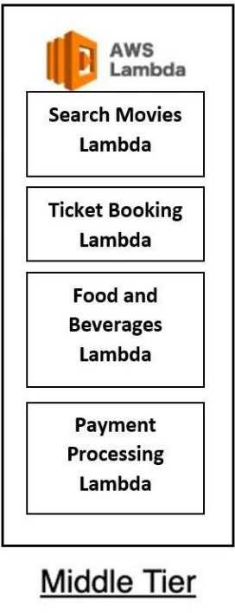
getuser
addnewuser
listofcities
listoftheaters
listofmovies
listofshowdates
listofshows
listofshowseats
addshowseats
listoffood
bookingcost
listoftickets
Notes:
Search Movies
'/listofcities'
'/addnewuser'
'/listoftheaters';
'/listofmovies';
'/getuser’;
Ticket Booking
'/listofshowdates';
'/listofshows';
'/listofshowseats';
'/addshowseats’
Food Ordering
Listoffood
Payment Processing
Bookinngcost
listoftickets

Slide 19
Functionalities of the Lambda function
Search Movies Lambda: Adds the users to the database and helps them search movies based on theaters and cities..
Ticket Booking Lambda: Displays the available shows based on time and date and helps the user book seats in a selected theater.
Food and Beverages Lambda: Helps the user pre-order food before the movie starts
Payment Processing Lambda: Displays the total cost of tickets and food to the user and displays ticket information containing the seat number, show time, theater name, city and the total cost of the ticket.

Slide 20
05
CLIENT INTERFACE

Slide 21
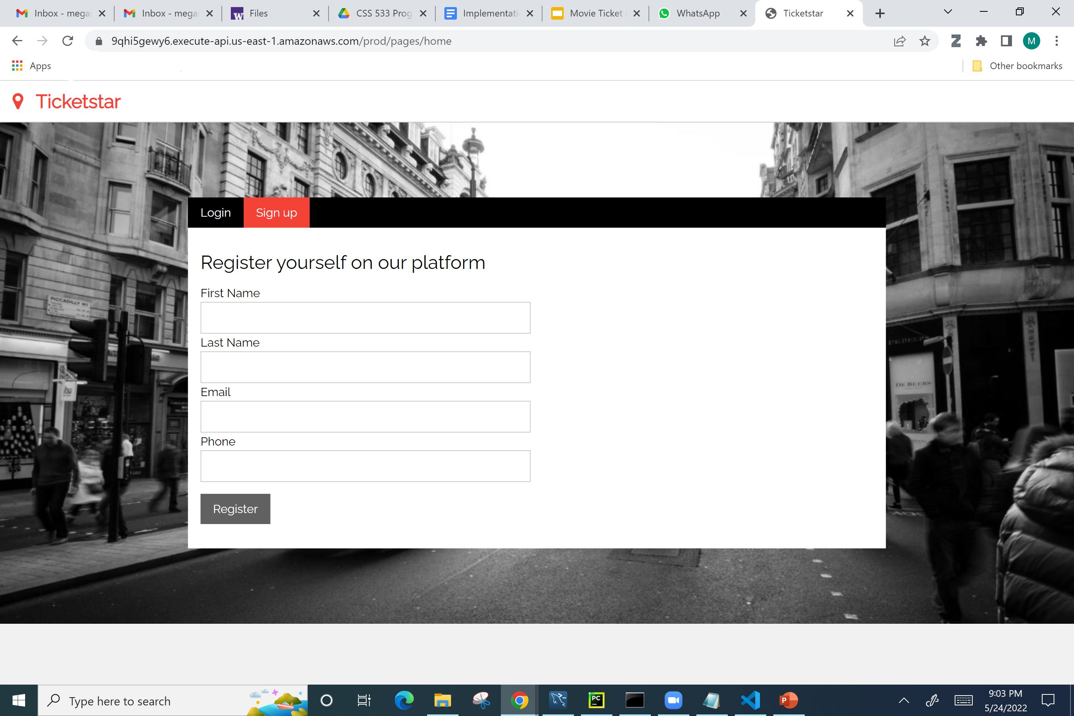

Slide 22
06
DEMO

Slide 23
REFLECTIONS
Challenges
Successes
Future Directions
Familiarize ourselves with technologies
Difficulty in coming up with the correct design and implementation details
Needed to perform a lot of trial and error
Underestimated the scope of project and efforts needed to complete it
Delivered a working ticket booking system with planned functionalities
Went above and beyond planned CLI and built a Front-End
Learnt new technologies and gained confidence in Distributed Computing.
Yes we were able implement everything in our initial proposal except implementing the Cache and a replication database.
Create an administrative user with features to modify the database
Make product more scalable with more users and theaters

Slide 24
Thank You!

